Slide 1

Google Developer Student Clubs
Welcome to DSA KICKSTART
- Nilesh Telang

Slide 2
Data Structures and Algorithms
DS Definition :
Data structures are ways of organizing and storing data in a computer's memory.
They provide a means to manage and manipulate data efficiently.
Common data structures include arrays, linked lists, stacks, queues, trees, graphs, and hash tables .
Algorithms Definition :
Algorithms are step-by-step procedures or sets of rules for solving specific computational problems.

Slide 3
Programming Languages
Easy Learning
C++
Java
Python
Performance but complex
Strong Typing

Slide 4
Programming Languages
Syntax and Readability | Less Readable Verbose and complex syntax ‘ {} ‘ used | Less Readable Verbose and complex syntax ‘ {} ‘ used | Clean Readable Simplicity
Compilation vs. Interpretation | Compiled | Compiled | Interpreted
Static vs. Dynamic Typing | Statically typed Must declare the data type of a variable at the time of declaration | Statically typed | Dynamically typed
Differences
Java
C++
Python

Slide 5
Memory Management | Automatic memory management (garbage collection) | Manual memory management capabilities through pointersVerbose and complex syntax Prone to errors | Automatic memory management (garbage collection)
Platform Independence | Platform-independent Java Virtual Machine (JVM) | Less Portable Dependent | Mostly platform-independent Platform-specific libraries may introduce some limitations
Community and Popularity | Enterprise applications Android app development | Game development Embedded systems | Data science Machine learning Web development
Differences
Java
C++
Python

Slide 6

Let’s go then . . .

Slide 7
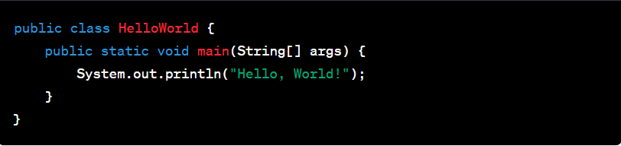
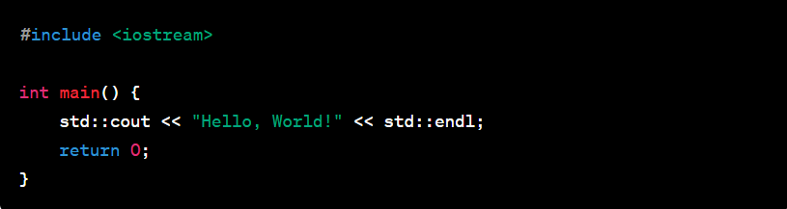
Hello World
Python
Java
C++

Slide 8
Variables and Data Types
In programming, variables are used to store and manage data. To declare a variable, you give it a name and specify its data type.
Data Types
Common data types in programming include :
Integer (int): Stores whole numbers.
Float (or Double): Stores numbers with decimal points.
String: Stores sequences of characters (text).
Boolean: Stores either True or False.

Slide 9
Data Type | Size (in Bytes) | Range
byte | 1 | -128 to 127
short | 2 | -32K to 32K
int | 4 | -2B to 2B
long | 8 | -9,223,372,036,854,775,808 to 9,223,372,036,854,775,807
float | 4 | Upto 7 decimal digits
double | 8 | Upto 16 decimal digits
char | 2 | a, b, c .. A, B, C .. @, #, $ ..
bool | 1 | True, false

Slide 10
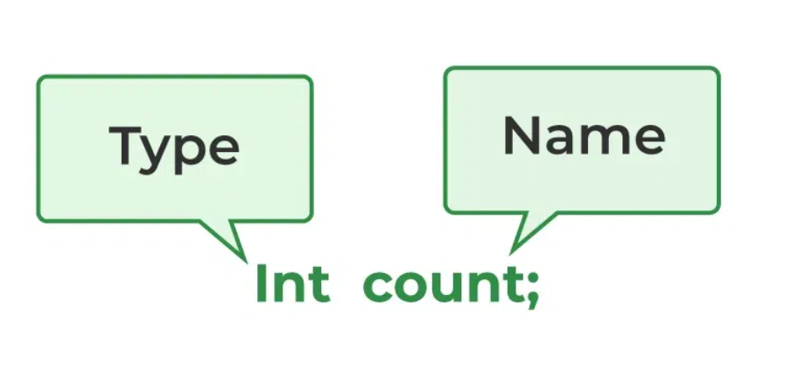
Variable Declaration:
In most programming languages, you declare a variable before using it. This declaration involves specifying the variable's name and data type.
For example, in Python, you can declare an integer variable like this:
age = 25

Slide 11
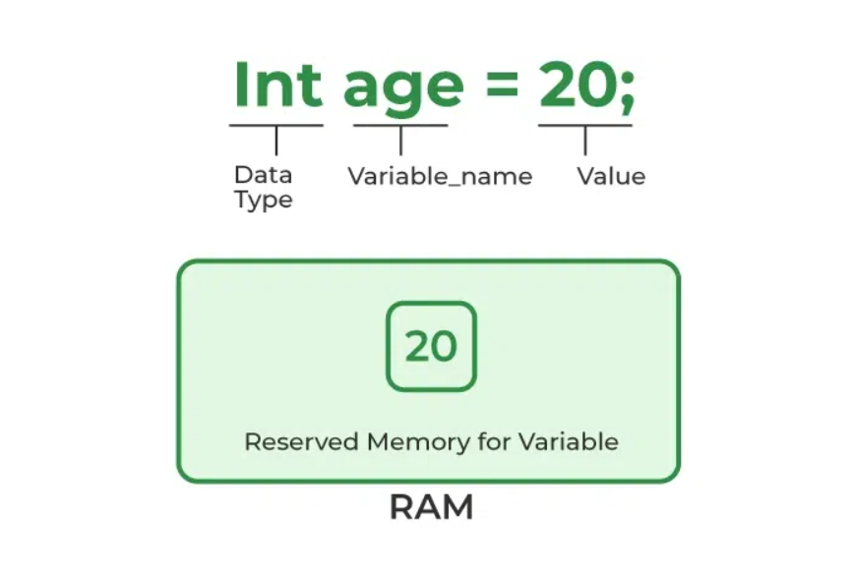
Variable Initialization:
To store a value in a variable, you use the assignment operator, which varies from language to language.
The assignment operator typically takes the form of an equal sign (=).
For example:
name = "John"

Slide 12
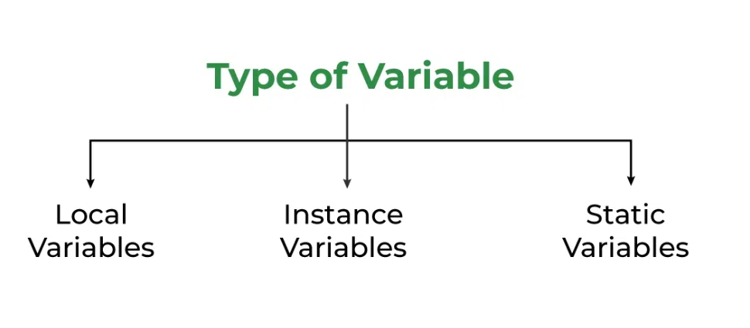
3. Static Variables
Variables are declared similarly to instance variables. The difference is that static variables are declared using the static keyword within a class outside of any method, constructor, or block.
Local Variables
A variable defined within a block or method or constructor is called a local variable.
2. Instance Variables
Instance variables are non-static variables and are declared in a class outside of any method, constructor, or block.

Slide 13
Python
age = 25 # Integer variable
name = "John" # String variable
print("Age:", age)
print("Name:", name)
Java
public class VariablesExample {
public static void main(String[] args) {
int age = 25; // Integer variable
String name = "John"; // String variable
System.out.println("Age: " + age);
System.out.println("Name: " + name);
}
}

Slide 14
C++
#include <iostream>
#include <string>
int main() {
int age = 25; // Integer variable
std::string name = "John"; // String variable
std::cout << "Age: " << age << std::endl;
std::cout << "Name: " << name << std::endl;
return 0;
}

Slide 15
Input and Output
Python
name = input("Enter your name: ")
print("Hello, " + name)
Input:
To take input from a user, you can use functions like input() in Python.
The input() function displays the message inside the parentheses and waits for the user to enter text.
The entered text is stored in the variable name.
Output:
To display output to the screen, you can use the print() function in Python:
The print() function displays the text inside the parentheses.

Slide 16
Java
import java.util.Scanner;
public class InputOutputExample {
public static void main(String[] args) {
Scanner scanner = new Scanner(System.in);
System.out.print("Enter your name: ");
String name = scanner.nextLine();
System.out.println("Hello, " + name);
}
}

Slide 17
C++
#include <iostream>
#include <string>
int main() {
std::string name;
std::cout << "Enter your name: ";
std::getline(std::cin, name);
std::cout << "Hello, " << name << std::endl;
return 0;
}

Slide 18
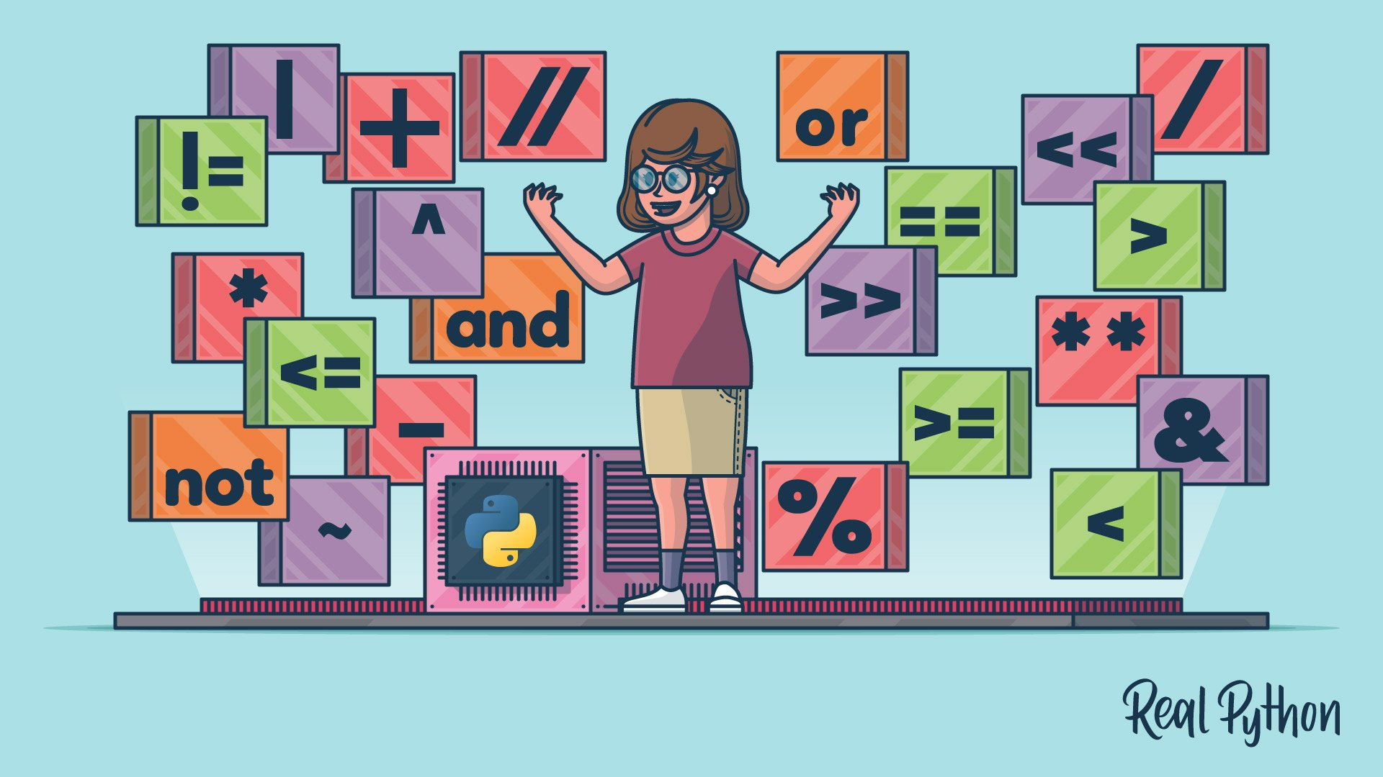
Operators and Expressions
Operators:
Operators are used for performing operations on data.
Common operators include:
Arithmetic operators (e.g., +, -, *, / for addition, subtraction, multiplication, and division).
Comparison operators (e.g., ==, !=, <, >, <=, >= for equality and comparisons).
Logical operators (e.g., and, or, not for combining conditions).
Expressions :
An expression is a combination of variables, values, and operators. For example:
Result = 10 + 5

Slide 19
2 . Assignment Operators
Operator | Operation | Example
= | Assigns value of right operand to left operand | A=B will put value of B in A
+= | Adds right operand to the left operand and assigns the result to left operand. | A+=B means A = A+B
-= | Subtracts right operand from the left operand and assigns the result to left operand. | A-=B means A=A-B
*= | Multiplies the right operand with the left operand and assigns the result to the left operand. | A*=B means A=A*B
/= | Divides left operand with the right operand and assigns the result to left operand. | A/=B means A=A/B

Slide 20
3 . Comparison/ Relational Operators
Operator | Operation | Example
== | Gives true if two operands are equal | A==B is not true
!= | Gives true if two operands are not equal | A!=B is true
> | Gives true if left operand is more than right operand | A>B is not true
< | Gives true if left operand is less than right operand | A<B is true
>= | Gives true if left operand is more than right operand or equal to it | A>=B is not true
<= | Gives true if left operand is less than right operand or equal to it | A<=B is true

Slide 21
4 . Logical Operators
Operator | Operation | Example
&& | AND operator. Gives true if both operands are non zero | (A && B) is false
|| | OR operator. Gives true if atleast one of the two operands are non-zero. | (A || B) is true
! | NOT operator. Reverse the logical state of operand | !A is true

Slide 22
Other Operators
Bitwise Operators:
& (Bitwise AND)
| (Bitwise OR)
^ (Bitwise XOR)
~ (Bitwise NOT)
<< (Left shift)
>> (Right shift)
>>> (Unsigned right shift)
Conditional (Ternary) Operator:
? : (Conditional operator, also known as the ternary operator)
Increment and Decrement Operators:
++ (Increment)
-- (Decrement)

Slide 23
Python
x = 10
y = 5
sum = x + y # Addition
difference = x - y # Subtraction
product = x * y # Multiplication
quotient = x / y # Division
isGreater = x > y # Comparison
print("Sum:", sum)
print("Difference:", difference)
print("Product:", product)
print("Quotient:", quotient)
print("Is x greater than y?", isGreater)

Slide 24
Java
public class OperatorsExpressionsExample {
public static void main(String[] args) {
int x = 10;
int y = 5;
int sum = x + y; // Addition
int difference = x - y; // Subtraction
int product = x * y; // Multiplication
int quotient = x / y; // Division
boolean isGreater = x > y; // Comparison
System.out.println("Sum: " + sum);
System.out.println("Difference: " + difference);
System.out.println("Product: " + product);
System.out.println("Quotient: " + quotient);
System.out.println("Is x greater than y? " + isGreater);
}
}

Slide 25
C++
#include <iostream>
int main() {
int x = 10;
int y = 5;
int sum = x + y; // Addition
int difference = x - y; // Subtraction
int product = x * y; // Multiplication
int quotient = x / y; // Division
bool isGreater = x > y; // Comparison
std::cout << "Sum: " << sum << std::endl;
std::cout << "Difference: " << difference << std::endl;
std::cout << "Product: " << product << std::endl;
std::cout << "Quotient: " << quotient << std::endl;
std::cout << "Is x greater than y? " << isGreater << std::endl;
return 0;
}

Slide 26
Control Structures
Conditional statements allow you to make decisions in your code.
Python
age = 20
if age >= 18:
print("You are an adult.")
else:
print("You are a minor.")
In this example, the if statement checks if age is greater than or equal to 18.
If the condition is true, it executes the code inside the first block. If false, it executes the code inside the else block.

Slide 27
Java
int day = 2;
String dayName;
switch (day) {
case 1:
dayName = "Sunday";
break;
case 2:
dayName = "Monday";
break;
case 3:
dayName = "Tuesday";
break;
// Add more cases for other days
default:
dayName = "Invalid day";
}
System.out.println("Today is " + dayName);

Slide 28
C++
#include <iostream>
int main() {
int age = 20;
if (age >= 18) {
std::cout << "You are an adult." << std::endl;
} else {
std::cout << "You are a minor." << std::endl;
}
return 0;
}
Conditional (Ternary) Operator:
? : (Conditional operator, also known as the ternary operator)

Slide 29
Thanks for Listening with great patience

